Slide 1
“Not Only SQL” Data Storage Options for .NET
Alex Garland

Slide 2


About Me
Senior Database Developer
-> MS SQL Server, Hadoop (HDFS)
Senior Data Engineer
-> Hadoop, Hive, Impala, Spark
www.alexdgarland.com www.twitter.com/alexdgarland

Slide 3
In This Presentation…
Theory, context
Comparison of database systems, architectures
Code examples!
https://github.com/alexdgarland/database-demos

Slide 4

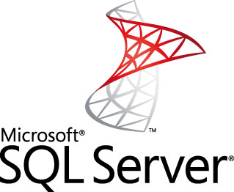


10 Years Ago
Application/“OLTP” Data Warehouse/ “OLAP”

Slide 5
Relational – The Good Parts
Flexible - Good “All-Rounder”
Strong Theoretical Basis (Maths/ Logic, ACID)
Plain-English Query Language (SQL)
Mature Technology

Slide 6
So What’s Not To Like?
Programming Model:
Object-Relational Impedance Mismatch
Schema Changes
Separation of Skill-Sets/ Expertise
Scalability
Notes:
(Audience Participation)

Slide 7
Serialization
“Across The Wire” – Binary, XML, JSON
MS SQL Server – Binary, XML
PostgreSQL – JSON

Slide 8
(Serialization Demo)

Slide 9


Vertical Scaling

Slide 10
Vertical Scaling
Simple – No Change to Fundamental Architecture
BUT:
Expensive – Non-Linear Cost Increases
Increasingly Specialist Hardware
No Redundancy

Slide 11
Horizontal Scaling

Slide 12
Horizontal Scaling
Linear (or better) increases in cost to scale
BUT – increased complexity of architecture/ programming model
Especially challenging for data storage

Slide 13
Horizontal Scaling – “Read-Mostly”
Master-Slave Replication
Slaves
Read Traffic
Write Traffic
Load Balancer/ App Server(s)
Write Replication
Master
Notes:
The feasibility of scaling horizontally really depends on the required workload. If we’re dealing mostly with reads, we can use what’s called master-slave replication. Basically, there is still one definitive version of the data – the master – and all writes are sent there. We then push data out (replication techniques vary…) to copies of the master – these are the slaves. These multiple servers allow us to respond to many more read requests.
The key thing to note here is that there is still only a single server for the write workload, and if anything it is doing more work than before (it also has to do some sort of work to broadcast changes to the slaves). So if we have a lot of writes, we are going to either run into the same problems with vertical scaling as before, or need to move to an alternative (probably more complex) architecture.
NB: A “write-heavy” workload doesn’t need to mean a strict majority of requests are writes, just that there are enough that this architecture of having one master, many slaves is not going to work.

Slide 14
Horizontal Scaling – “Write-Heavy”
Database Sharding
Write Traffic
Read Traffic
Data Distribution Strategy
Shard A
Shard B
Shard C
Shard D
Notes:
One of the main ways that most database systems (including relational) can be scaled up horizontally for write workloads is through sharding.
At the highest level, sharding is relatively straightforward. We store distinct parts of the data on each of several nodes. Each node handles both reads and writes, so we can handle plenty of both types of traffic.
However – the devil is in the detail – what strategy do we use to distribute the data? – making sure our application knows where to send data to and retrieve it from? How do we make sure we keep data sufficiently and evenly distributed? This can add complexity to sharding, and traditional relational databases don’t always make this easy “out of the box”.

Slide 15
What is NOSQL?
Early 2000’s – “Web-Scale” companies
“Big Data” – 3 V’s
Volume
Velocity
Variety (Structured, Unstructured)
Tools for Massively Distributed Systems

Slide 16
CAP Theorem
Eric A. Brewer.
“Towards robust distributed systems”
Principles of Distributed Computing, Portland, Oregon, July 2000
https://www.cs.berkeley.edu/~brewer/cs262b-2004/PODC-keynote.pdf
Seth Gilbert, Nancy Lynch
“Brewer’s Conjecture and the Feasibility of Consistent, Available, Partition-Tolerant Web Services”
ACM SIGACT News Volume 33 Issue 2, June 2002
http://webpages.cs.luc.edu/~pld/353/gilbert_lynch_brewer_proof.pdf

Slide 17
CAP Theorem
We can guarantee (at most) two of:
Consistency
same data/ history on all nodes
Availability
ability to respond (fast)
Partition Tolerance
nodes/ communication may fail (non-negotiable)
blog.cloudera.com/blog/2010/04/cap-confusion-problems-with-partition-tolerance

Slide 18
CAP – A Simple Example
Network partition
a = 1
UPDATE: a = 3
a = 1
a = 1
a = 1
a = 1
UPDATE: a = 2

Slide 19
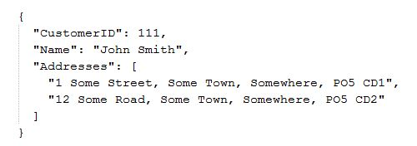
Document Databases
Extends the idea of document serialization to primary storage format

Slide 20
Document Databases
Less good at:
Protecting data integrity
Summary queries
Different CAP trade-offs
e.g.,
CouchDB (AP)
MongoDB (CP)

Slide 21

(MongoDB Demo)

Slide 22
“AP” Systems – Riak & Cassandra
“Aggregate” data models (as per document DBs) – avoid joins
Highly optimised for availability
Based on Amazon “Dynamo” paper
Tunable AP/ CP trade-offs

Slide 23
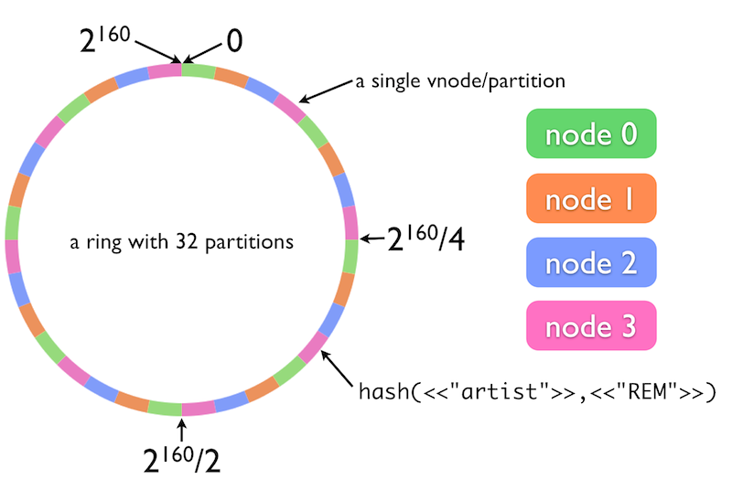
The Ring Model
http://docs.basho.com/riak/latest/theory/concepts/
Notes:
This is a model for data and load distribution that is shared by Riak and Cassandra (diagram is from Basho (Riak) website – but same principle), and has a deep impact on how they store, manage and retrieve data.

Slide 24
Tunable Consistency
Immediate vs Eventual
N, R & W Values – Strong, Quorum, Weak
“Read-Your-Writes”
Notes:
http://docs.basho.com/riak/latest/dev/advanced/cap-controls/
http://docs.basho.com/riak/1.1.0/references/appendices/concepts/Eventual-Consistency/

Slide 25

N, R & W
b = 10
c = 20
a = 1
a = 1
a = 2
b = 10
c = 20
a = 2
a = 1
b = 10
c = 20
N (total replicas) = 3
Satisfies W =
(minimum acknowledged writes)
1
2

Slide 26


Riak
Distributed Key-Value Store
Value = Any Binary Data
Open-Source
Developed/ Supported by Basho
Linux/ Erlang

Slide 27
(Riak Demo)

Slide 28


Apache Cassandra
AP Store for Structured (Column-Family) Data
Supported by DataStax
Free training - www.datastax.com/what-we-offer/products-services/training
Cassandra Query Language
Thrift -> CQL1 -> CQL2 -> CQL3
Model (superficially) similar to relational

Slide 29
(Cassandra Demo)

Slide 30
Cassandra Data Modelling
www.youtube.com/user/PlanetCassandra/search?query=model
Tables – But No Joins
Write Multiple Copies/ Views of Data
Row Storage Model(s)

Slide 31
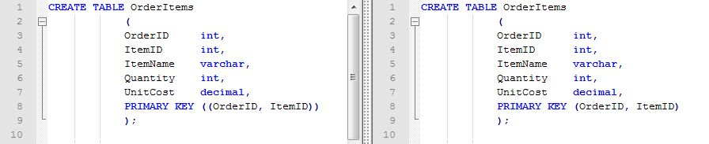
Cassandra Row Storage
Spot The Difference:

Slide 32

Cassandra Row Storage
Composite Row (Partition) Key
PRIMARY KEY ((OrderID, ItemID))
“Wide Rows” PRIMARY KEY (OrderID, ItemID)

Slide 33


Cloud Hosting
Amazon Web Services
Relational Database Service
Oracle/ MS SQL / MySQL/ Postgres/ Aurora, Read-Scaling
NoSQL
DynamoDB (Document/ Key-Value)
EC2 Hosting – MongoDB, Couchbase, other …
Google Cloud Platform
“Cloud SQL” (MySQL)
Cloud DataStore. BigQuery, DataFlow etc.

Slide 34

Cloud Hosting – MS Azure
Relational
NoSQL
DataStax Cassandra
Redis Cache
MongoLab
DocumentDB
Analytics
Hadoop – HDInsight, Cloudera
Machine Learning Services

Slide 35
DocumentDB (MS Azure)
Proprietary Microsoft NoSQL DB
JSON document format
Tunable Consistency
Caveats:
In preview
Vendor lock-in

Slide 36
(DocumentDB Demo)

Slide 37
Mixed Architectures
“Polyglot Persistence”
martinfowler.com/bliki/PolyglotPersistence.html
Different Business Processes
Read-Write Split -> Reporting

Slide 38
Business Processes (Amazon)
“For the checkout process you always want to honor requests to add items to a shopping cart because it's revenue producing. In this case you choose high availability. Errors are hidden from the customer and sorted out later.”
“When a customer submits an order you favor consistency because several services--credit card processing, shipping and handling, reporting--are simultaneously accessing the data.”
highscalability.com/amazon-architecture

Slide 39
Reporting Systems
Old-World – OLTP vs OLAP – Relational
New-World :
Separate Analytics (Hadoop, etc.)
Integrate with (e.g.) Cassandra
Streaming Analytics
Lambda Architecture

Slide 40
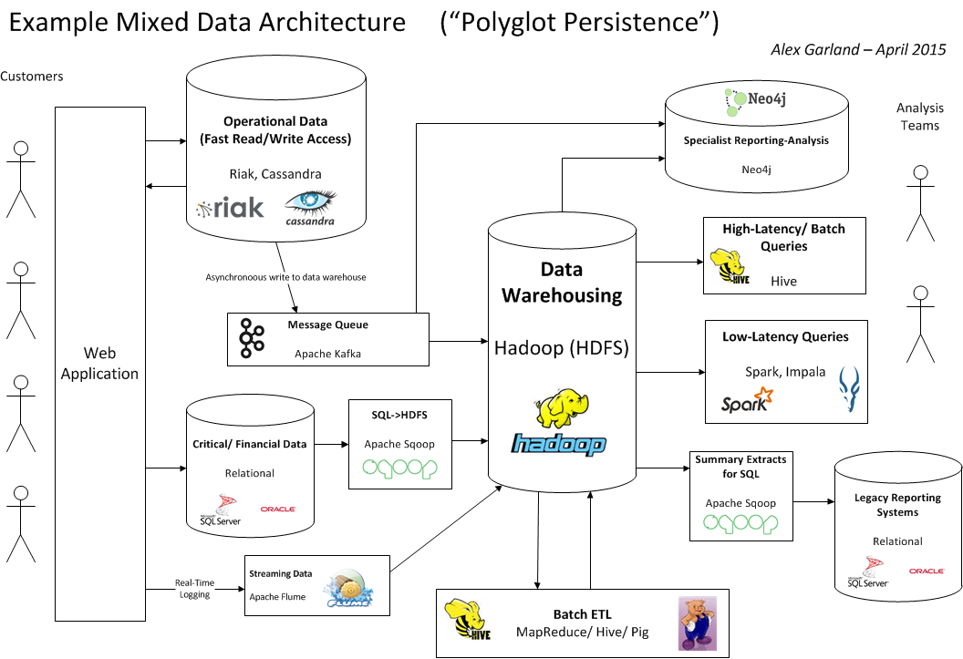

Slide 41




Hadoop
Basis - GFS, MapReduce etc.
Yahoo! – Doug Cutting
Apache Top-Level Project
“Big” Data-Warehousing (++)

Slide 42
Distributed File System (HDFS)
Distributed, CP, Append-Only FileSystem
High-Latency Access/ ETL via Java MapReduce
vs. -> HBase
Basis for other analysis/ query tools

Slide 43
Hadoop – Core Tools
Local File System
Hive
Pig
(Java API)
Map
Reduce
PUT
GET
HDFS
Hadoop Distributed File System

Slide 44
MapReduce
Method of aggregating data from multiple nodes
“Send the work to the data”
Also implemented in Riak, MongoDB (etc.)

Slide 45
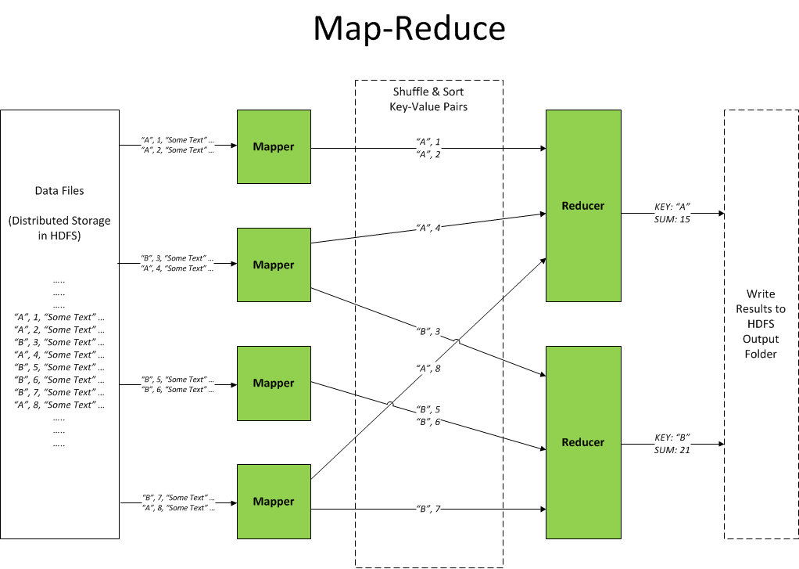

Slide 46
(Hadoop MapReduce Demo)

Slide 47


Hadoop Ecosystem
“Linux for Distributed Systems”
– HDFS, MapReduce, YARN
Related tools:
Hive, Pig, Spark, Impala, Mahout, Giraph, HBase, Cassandra, ZooKeeper, Ambari, Flume, Sqoop … (etc.) …
HortonWorks, Cloudera
3rd Party – e.g. HDInsight, SAS Visual Analytics

Slide 48
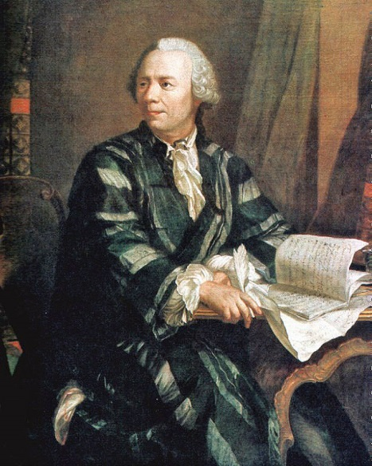
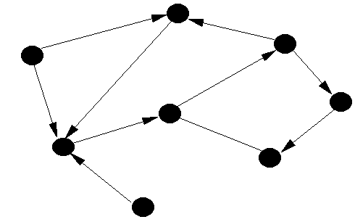
Graph Databases
Based on Graph Theory (Euler et al.)
Not relational – but not “standard” NoSQL

Slide 49

Neo4j
Easy to install, use
Expressive, flexible data model for related data
Use cases (YouTube playlist) - goo.gl/RrdQjp
ACID semantics, scalability limits as relational
More from me - http://alexdgarland.com/category/neo4j

Slide 50
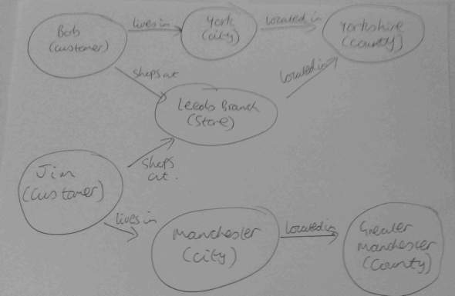
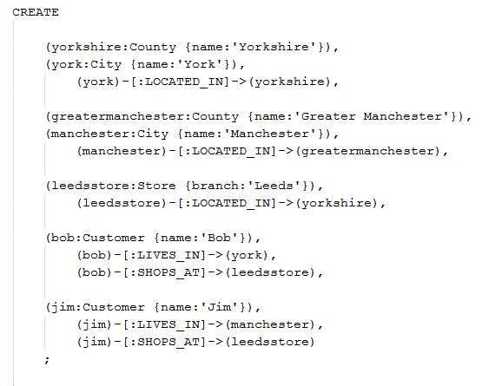
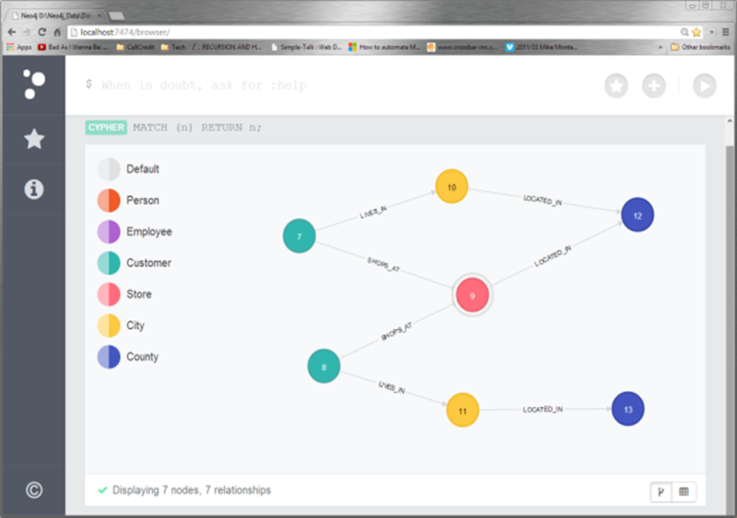
Neo4j – Data Model Design

Slide 51
Neo4j - Demo
Sketch -> Code -> Model
Client access (Neo4jClient)

